Slide 1
XtendFlex Soybeans
WinField United Local Campaign
ATLAS Materials

Slide 2
Topic: Using XtendFlex® Soybeans
SUBJECT LINE: Unlock Profitability Potential With XtendFlex® Soybeans
COPY:
Take advantage of a new tool to battle herbicide-resistant weeds.
As weeds become resistant to more herbicides, having technology like XtendFlex® soybeans provides new solutions for management of hard-to-control weeds, including common ragweed, Palmer amaranth and waterhemp.
XtendFlex soybeans are built on the proven high-yielding Roundup Ready 2 Xtend® technology and offer a triple herbicide trait stack that confers resistance to glyphosate, glufosinate and dicamba. With more herbicide application flexibility and agronomic benefits, that means there’s more opportunity to improve your bottom line.
Find even greater benefits with CROPLAN® soybeans.
If you choose to plant CROPLAN® soybean varieties with XtendFlex technology, you’ll get an added benefit to help mitigate risk in your fields.
CROPLAN will offer the XtendFlex trait in select WinPak® soybean varieties for the 2021 season. WinPak soybeans consist of two soybean varieties that complement each other with both offensive and defensive characteristics in one bag, offering another tool to help you better manage variability in your fields.
Contact us to learn more about how XtendFlex soybeans can help you meet your production goals in 2021.
No dicamba may be used in-crop with seed in the Roundup Ready® Xtend Crop System unless and until approved by the U.S. EPA and the appropriate state agency for such use. As of 8/1/2020, no dicamba formulations are currently registered by the U.S. EPA for in-crop use with seed in the Roundup Ready® Xtend Crop System in the 2021 season. Current stocks of dicamba herbicides previously approved for in-crop use with seed in the Roundup Ready® Xtend Crop System may not be used for the 2021 growing season. Dicamba may harm crops that are not tolerant to dicamba. Contact the U.S. EPA and your state pesticide regulatory agency with any questions about the approval status of dicamba herbicides products for in-crop use with seed in the Roundup Ready® Xtend Crop System. NOTICE: DO NOT APPLY ANY HERBICIDE TO SEED IN THE ROUNDUP READY® XTEND CROP SYSTEM UNLESS IT HAS A PRODUCT LABEL SPECIFICALLY AUTHORIZING THAT USE. TO USE A HERBICIDE IN ANY MANNER INCONSISTENT WITH ITS LABELING IS A VIOLATION OF FEDERAL LAW. REFER TO THE BAYER TECHNOLOGY USE GUIDE FOR DETAILS AND RECOMMENDATIONS ON USING APPROVED ROUNDUP® AND LIBERTY® BRANDED HERBICIDES ON SEED IN THE ROUNDUP READY® XTEND CROP SYSTEM. ALWAYS READ AND FOLLOW GRAIN MARKETING AND ALL OTHER STEWARDSHIP PRACTICES AND PESTICIDE LABEL DIRECTIONS. See the Products Use Notice at https://traits.bayer.com/soybeans/Pages/XtendFlex-Soybeans.aspx.
Important: Before use always read and follow label instructions. Crop performance is dependent on several factors many of which are beyond the control of WinField United, including without limitation, soil type, pest pressures, agronomic practices, and weather conditions. Growers are encouraged to consider data from multiple locations, over multiple years, and be mindful of how such agronomic conditions could impact results.
©2020 WinField United. CROPLAN®, WinPak® and WinField® are trademarks of WinField United.
Roundup Ready 2 Xtend® and XtendFlex® are registered trademarks of Bayer.

Slide 3
Topic: Additional Resources
News and Insights article, “Unlock More Profitability Potential With XtendFlex Soybeans”: https://www.winfieldunited.com/news-and-insights/unlock-more-profitability-potential-with-xtendflex-soybeans
News and Insights article, “5 Considerations to Help Choose the Right Soybean Trait Platform”: https://www.winfieldunited.com/news-and-insights/5-considerations-to-help-choose-the-right-soybean-trait-platform
Social Channel: Facebook or Twitter
Post 1:
We’re here to help you as you’re mapping out your seed decisions for next season. Learn how XtendFlex® soybeans can help you unlock more profitability potential with herbicide flexibility and better agronomics.
  Link to [Local retailer website]
Post 2:
If you feel like you’re running out of weed control options, XtendFlex® soybeans may be the right fit for your operation. Learn how the added herbicide options and latest genetics could improve your revenue potential in 2021.
  Link to: News and Insights article, “Unlock More Profitability Potential With XtendFlex Soybeans”: https://www.winfieldunited.com/news-and-insights/5-considerations-to-help-choose-the-right-soybean-trait-platform

Slide 4
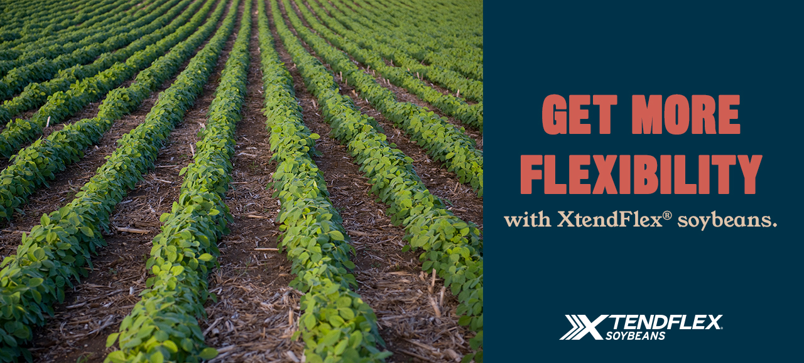
Email header

